Slide 1
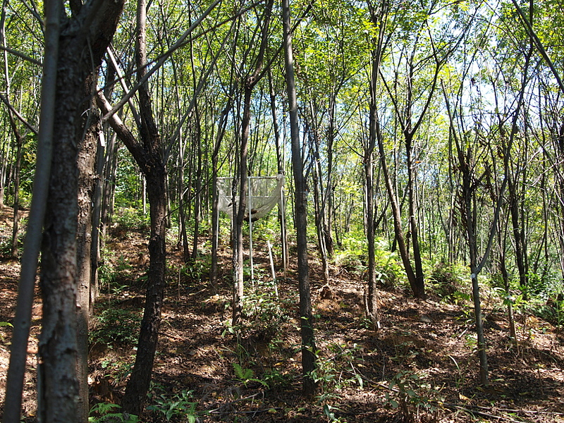
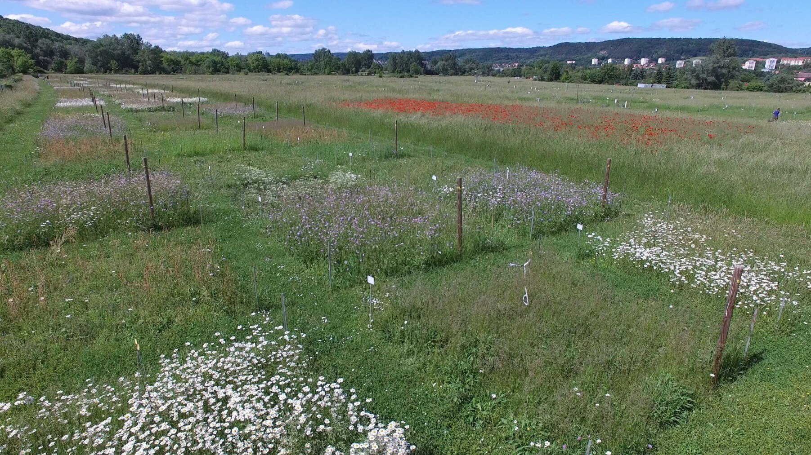
Biodiversity is declining→
Experimentally (and observationally) test BEF
Unstated Assumption
Before Humans
After Humans
Species
Area
Extinctions are linearly proportional across scales

Slide 2
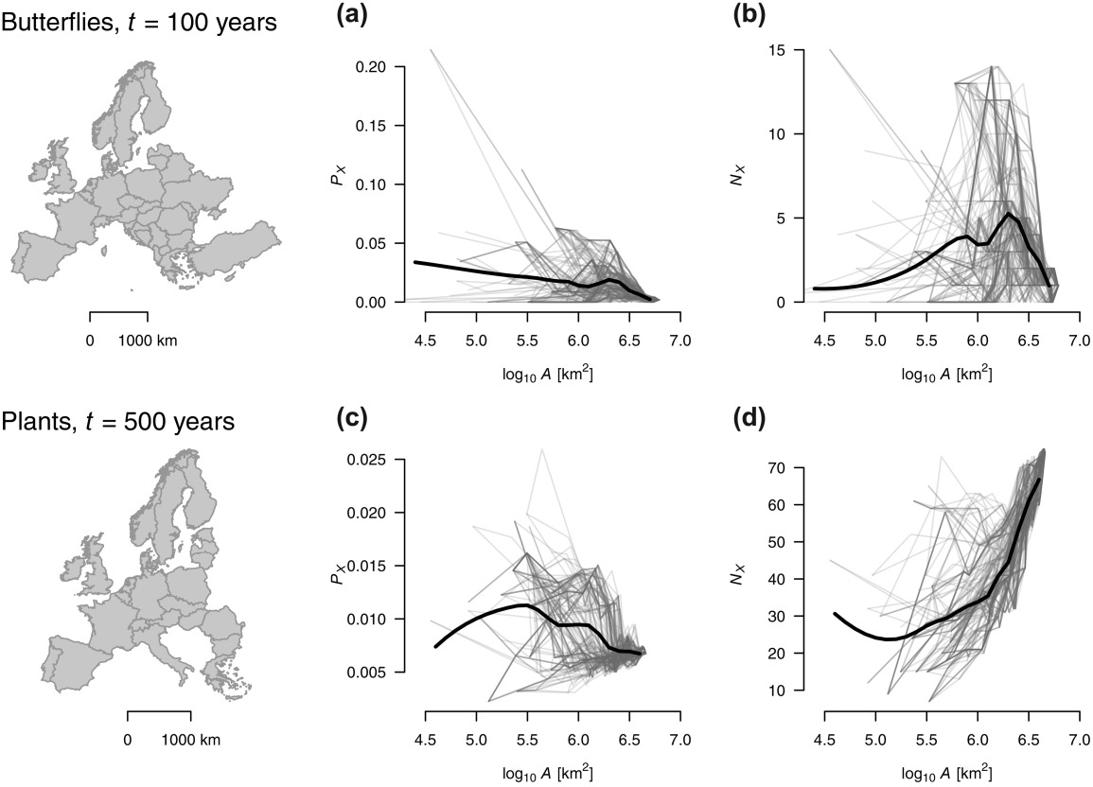


Extinction rates and biodiversity loss do not scale linearly
Keil et al. 2017 Global Ecology and Biogeography

Slide 3
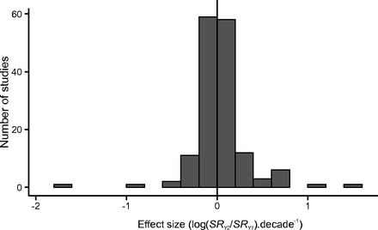
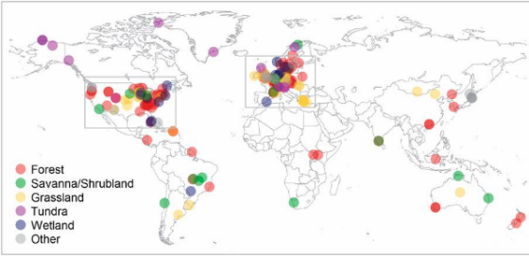
Is local diversity really declining?
If plant biodiversity is not generally declining at local spatial scales, what are the real world implications of small-scale biodiversity manipulation experiments?
Vellend et al. 2013

Slide 4
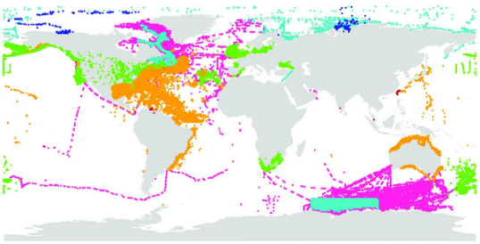
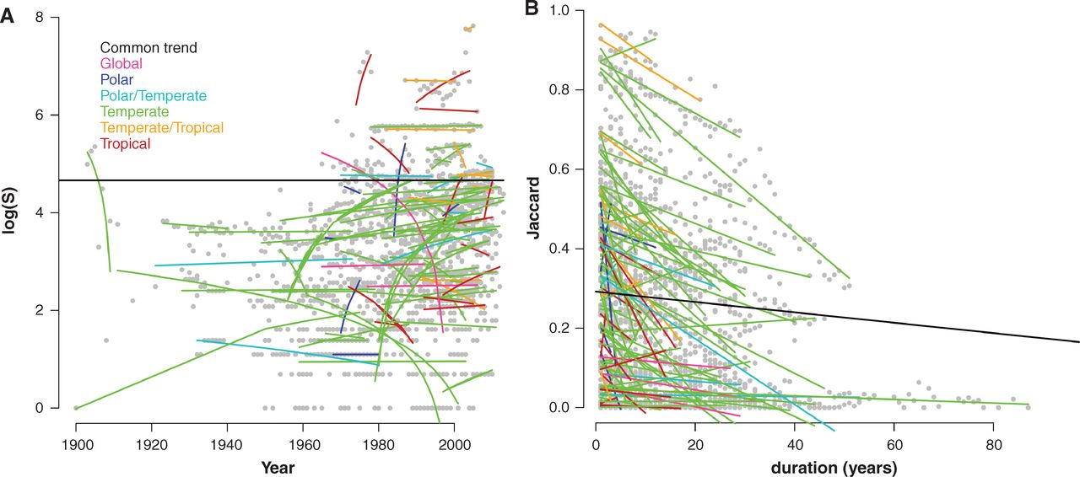

Slide 5
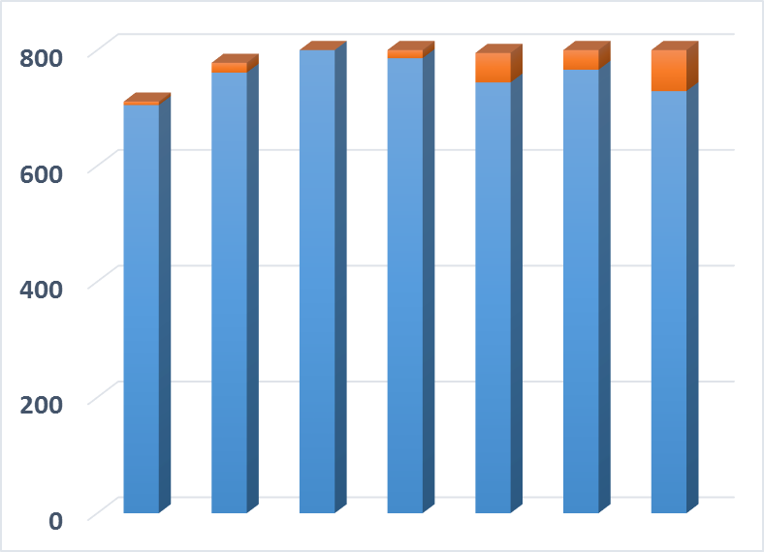
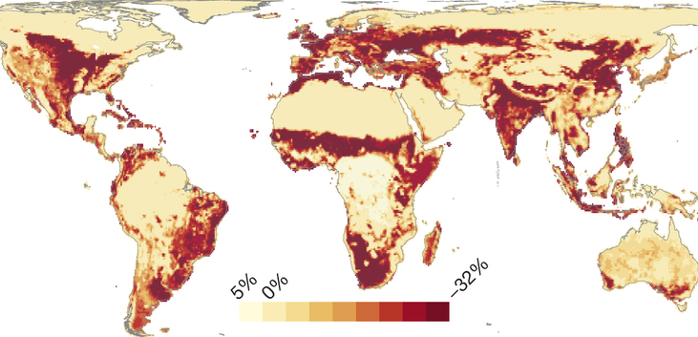
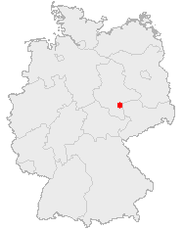


Towards synthesis…. Methods/approach matter
…As does scale
Number of Species
Public Domain, https://commons.wikimedia.org/w/index.php?curid=362363
~1700
1850
1950
~Today
Year
Data from: Knapp, S., et al. 2016. Journal of Applied Ecology
From the PREDICTS database
Newbold et al. 2015, Nature

Slide 6
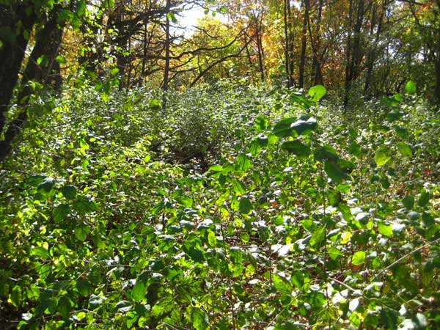
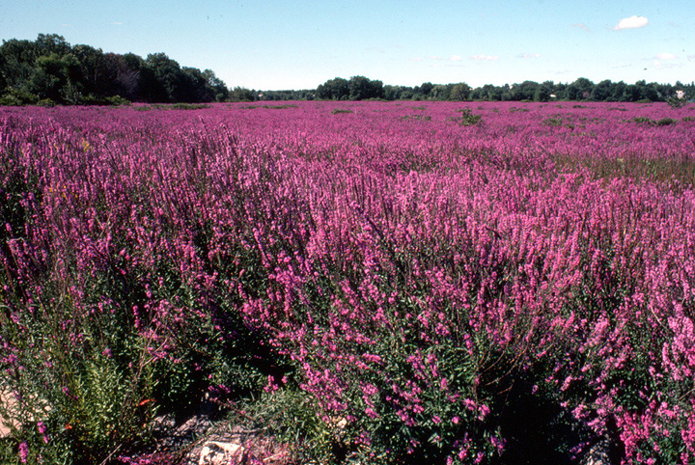

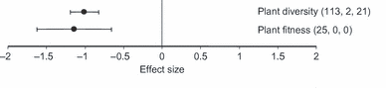
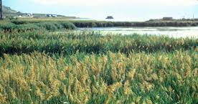
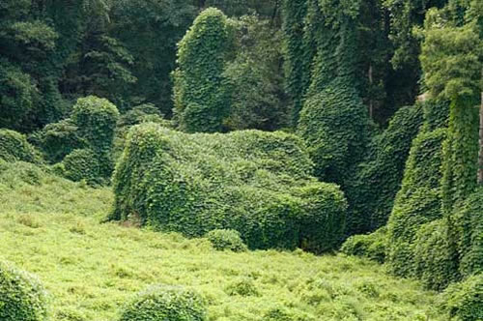
Thesis—
Alien species are the “second greatest threat” to biodiversity
Vila et al. 2011 Ecol. Letters
Murphy and Romanuk 2012, Am. Nat.

Slide 7

Anti-Thesis--

Slide 8
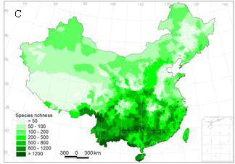
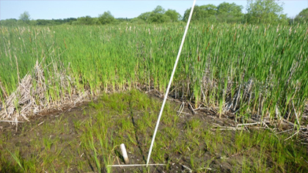
A Resolution? ……Spatial Scale
Experiments and meta-analyses
-Richness decreases
-Typically <<100 m²
-Richness → changes in relative abundance
Observations
-Little effect on richness
-Typically >>10,000 m²
-Richness → Local extirpation/extinction
Control=Invaded
Species Richness
Control
Invaded
Small
Spatial Scale
Large

Slide 9
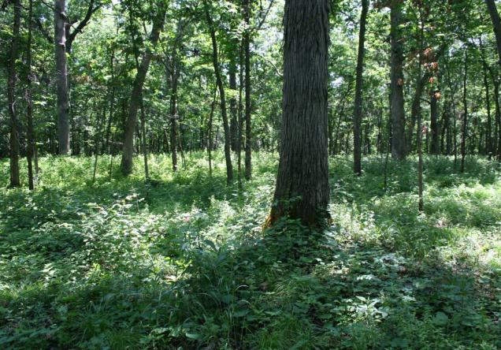
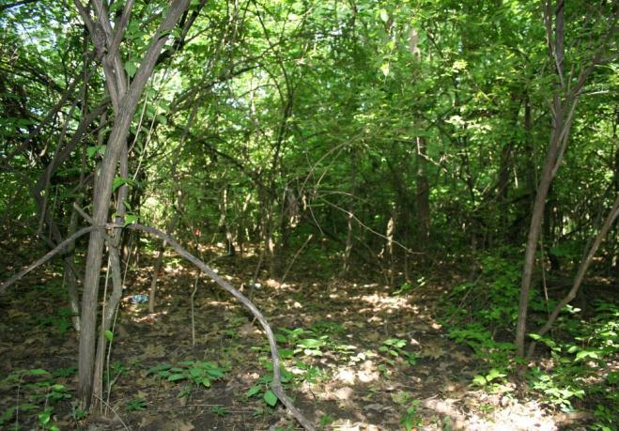
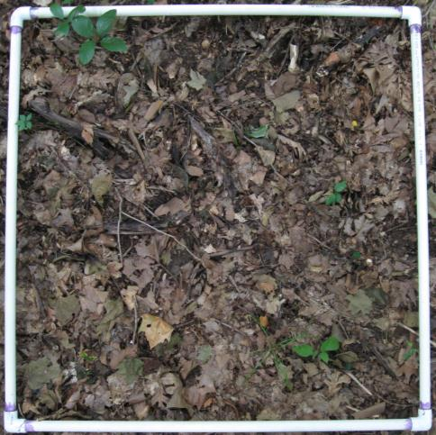
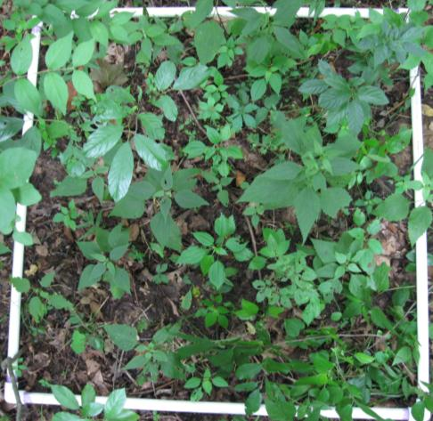
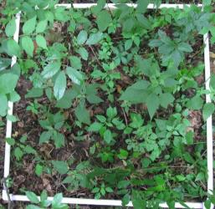

Scale-dependence of invasive species impacts
2.0
R²=0.995, P<0.001
R²=0.978, P=0.001
1.5
Log(Species Richness)
1.0
Uninvaded
Invaded
0.5
0
1
2
3
Log(Area)
Powell, Chase, Knight 2013. Science

Slide 10
A Neutral Sampling Effect
Degraded Community
Pristine Community
Small Effect
Large effect
10
Species Richness
8
6
4
2
0
0 30 60 90 120 150 180
Area Sampled
Chase and Knight 2013 Ecology Letters

Slide 11

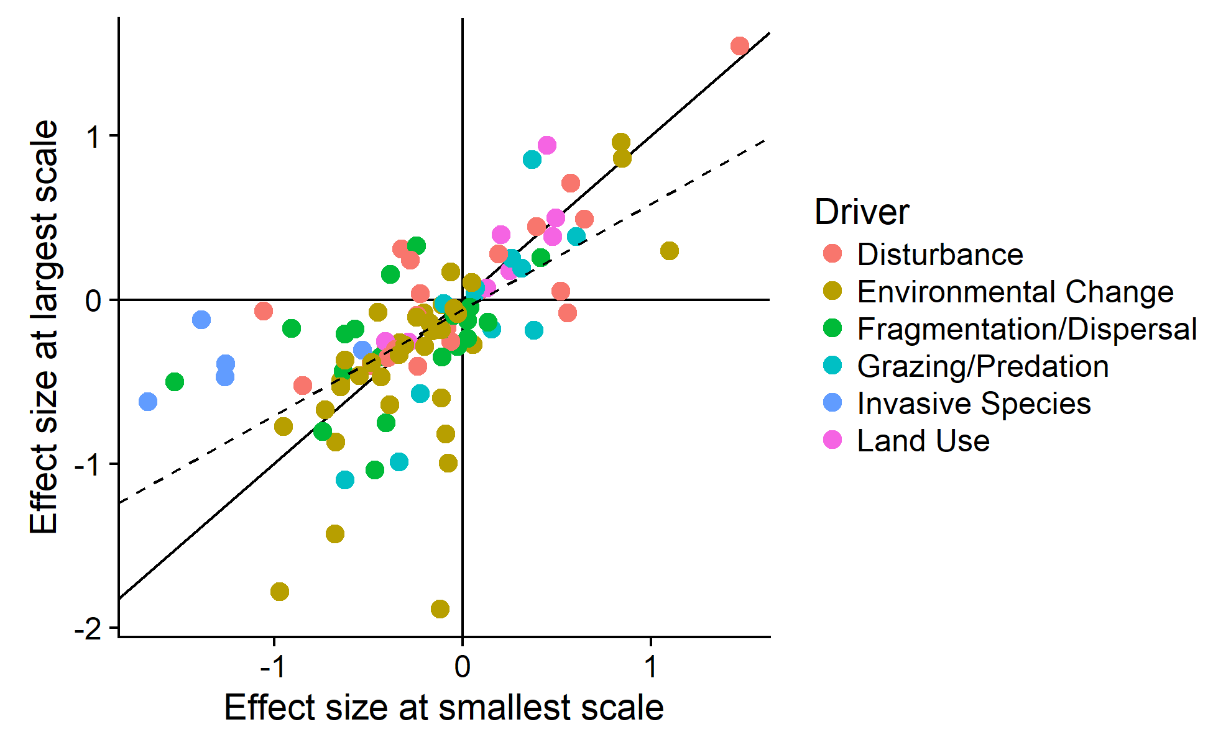





Scale-Dependence is the Rule
Small-scale Observations Often Overestimate Effects at Larger Scales
Opposite of homogenization
→Differentiation
Chase et al. 2018, Ecol. Lett.

Slide 12
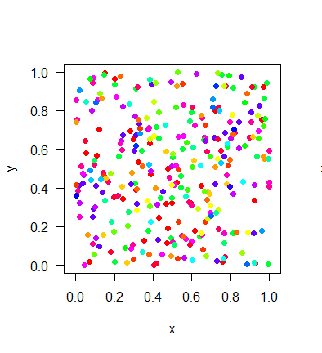
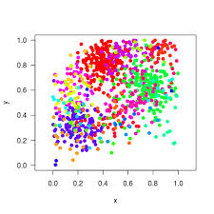




Scale-dependence is inevitable….
Species Richness
x
Sampling Effort
Co-variates

Slide 13
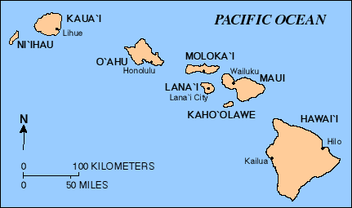

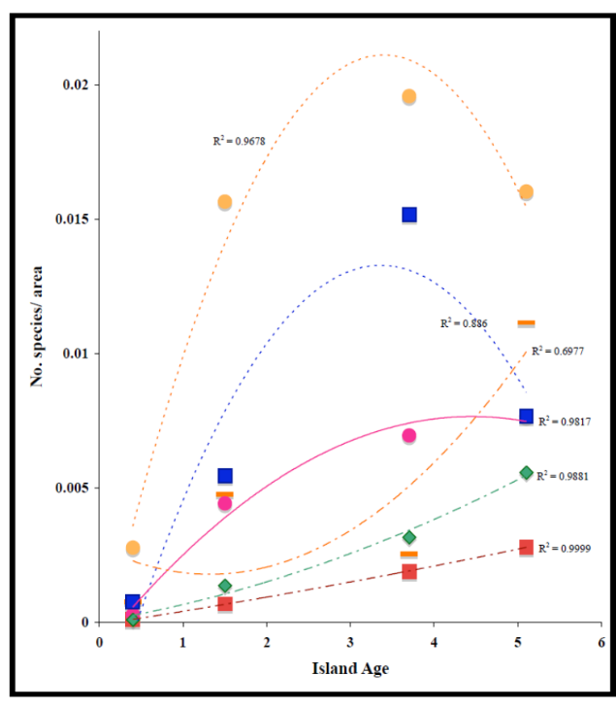


Can’t we just correct or statistical control for area?
“But isn’t this just ‘rarefaction’ all over again?”
…. Yes!!
Gillespie and Baldwin 2009

Slide 14
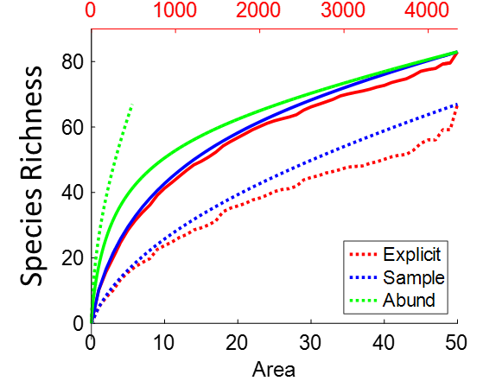

New (and old) metrics, new approaches, new analytical tools
Difference controlling for Aggregation
Difference Controlling for N
Observed difference in S
An R package: Measurements of Biodiversity (MoB)
McGlinn et al. 2019 Methods Ecol. Evol.

Slide 15
Discussion: The local biodiversity change debate

Slide 16
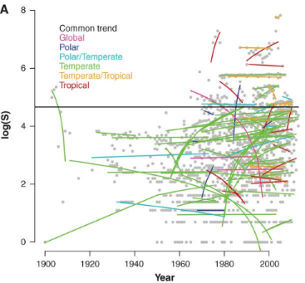
Is local diversity really declining?

Slide 17
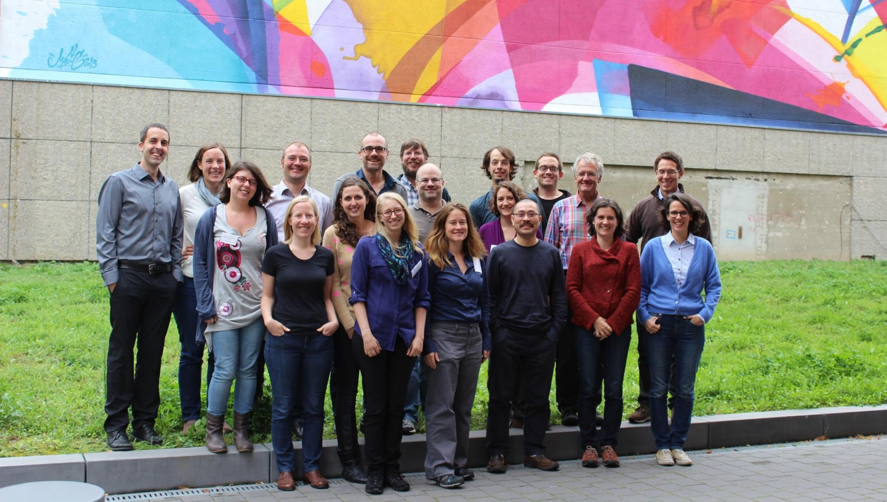

Slide 18
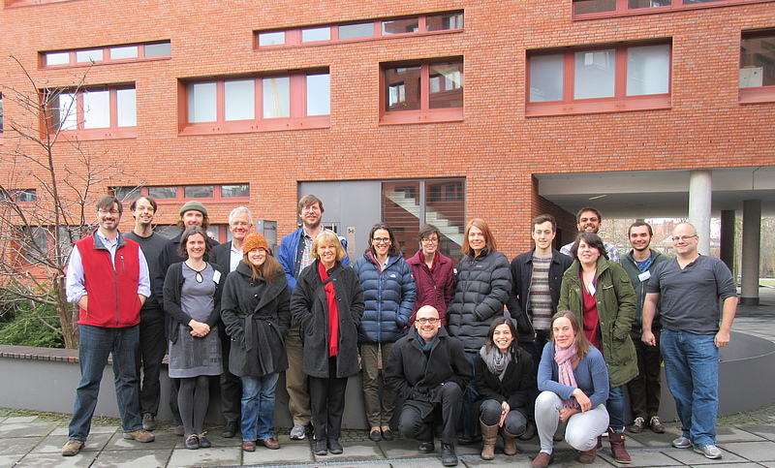

Slide 19



Species Richness
Species Turnover
Blowes et a. 2019 Science

Slide 20

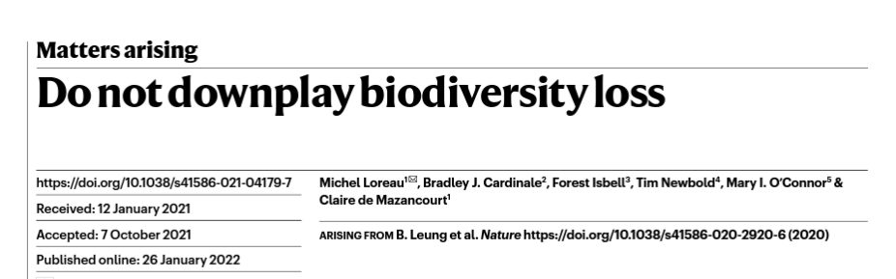
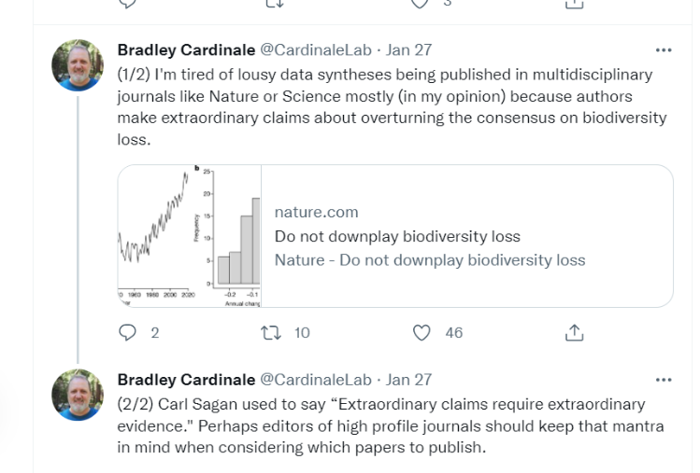


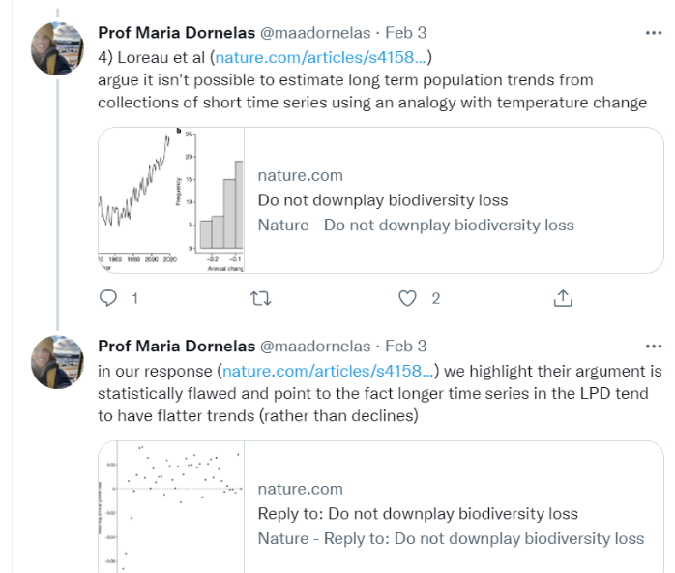

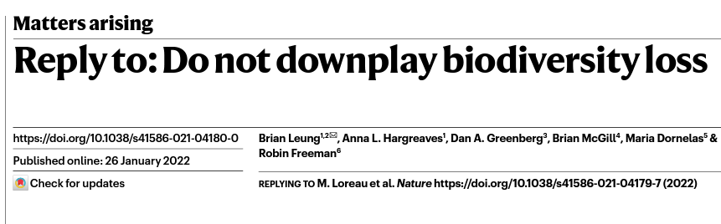

Slide 21
